Slide 1
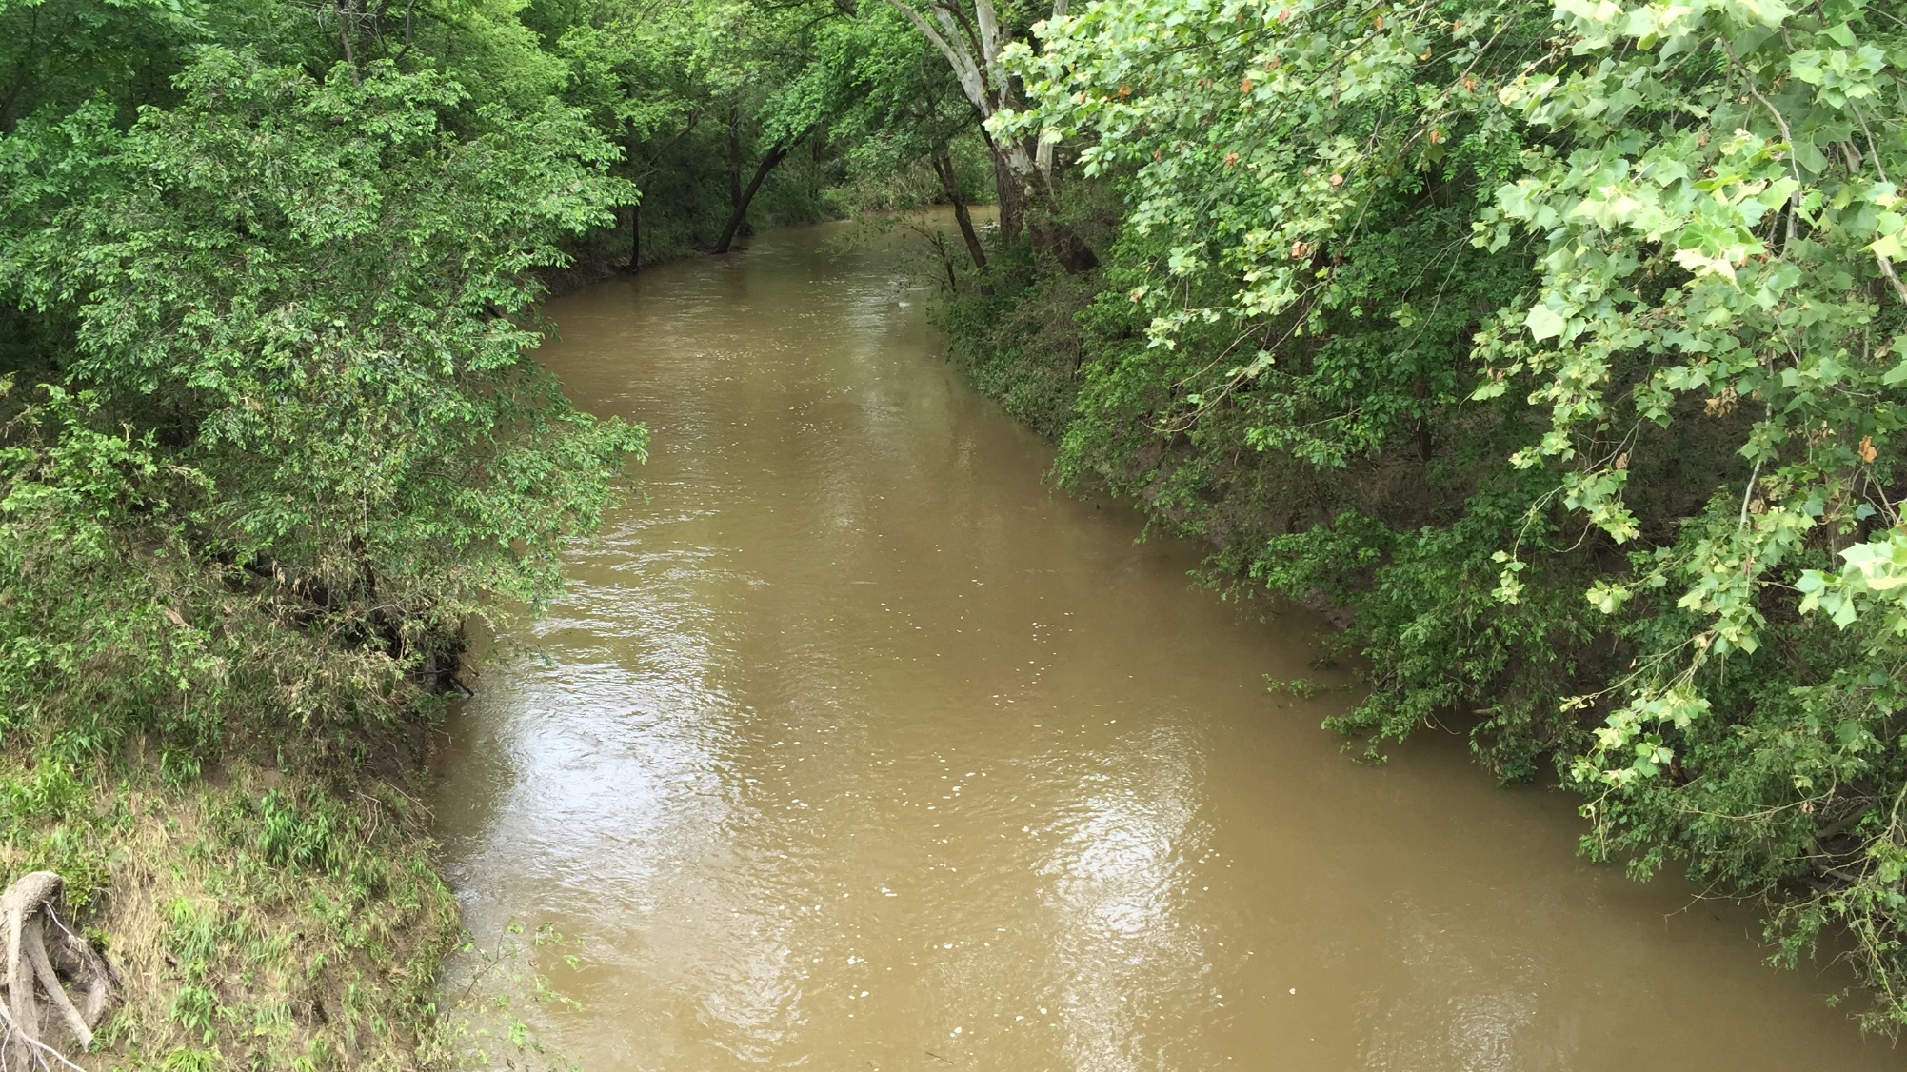
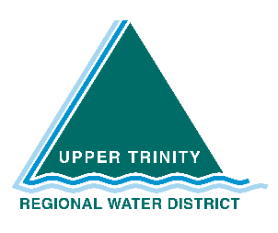
Water Quality Committee : Watershed Ordinances
Jason Pierce, Mgr. Governmental Affairs & Communications

Slide 2
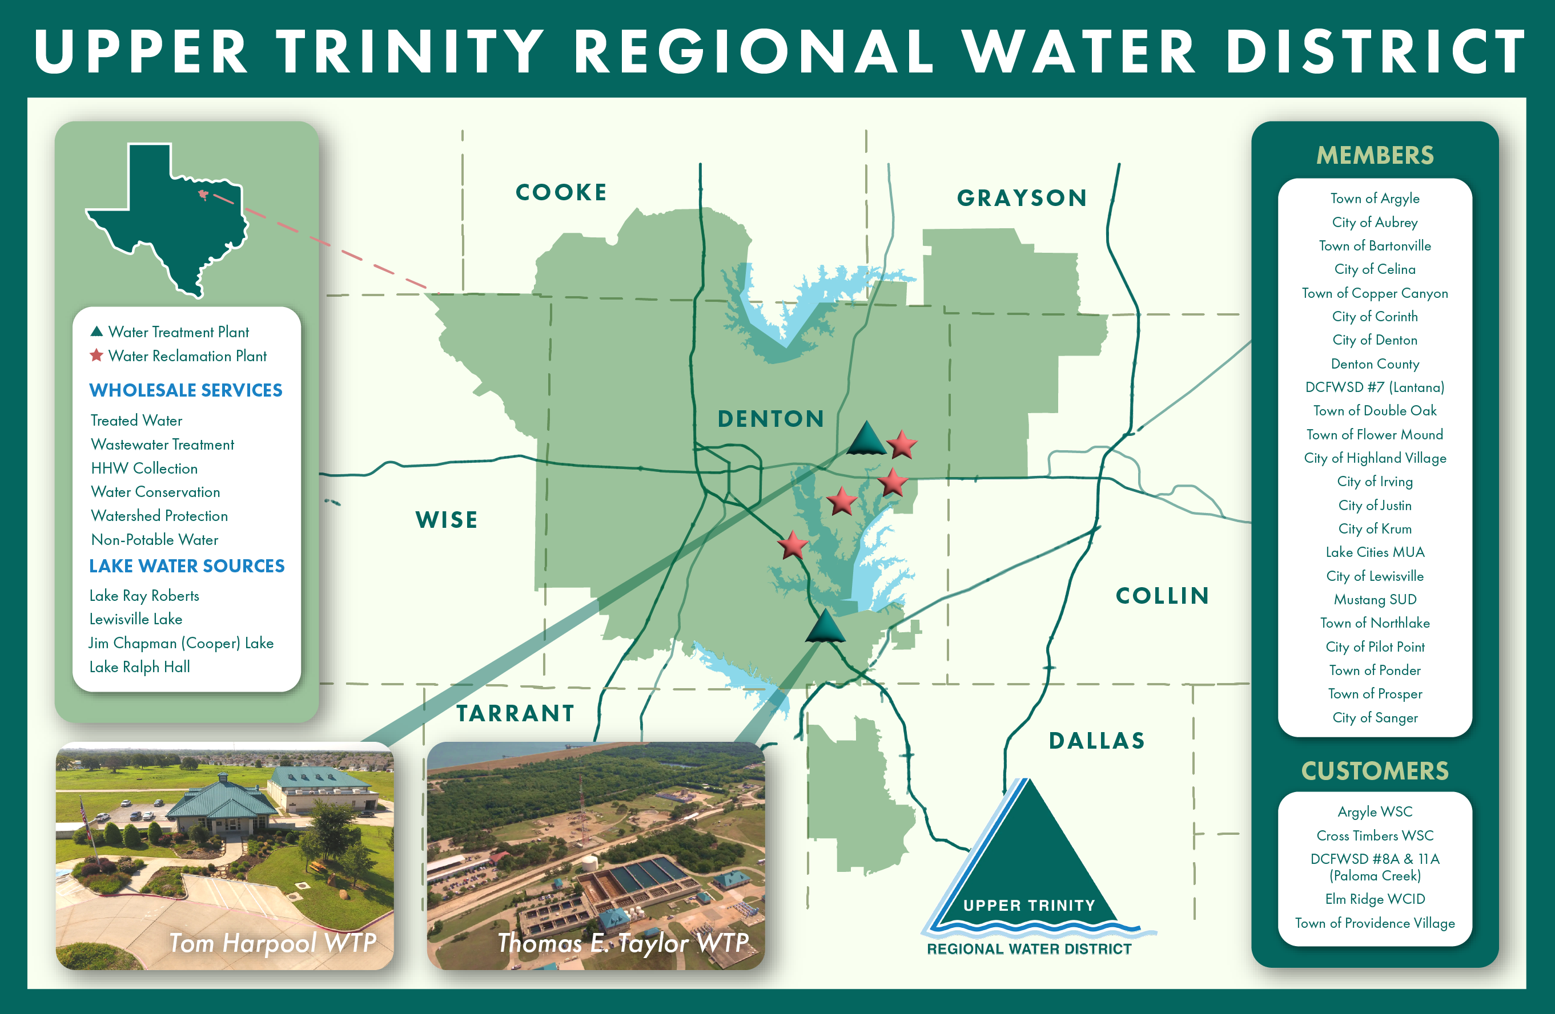
Notes:
UTRWD is a regional, wholesale provider of treated water and wastewater services - - currently serving approximately 400K people
Population is expected to increase 5-fold over the next 50 years - - many are not brining water with them; pressure on available water supply - - must consider impact on water quality as well.

Slide 3
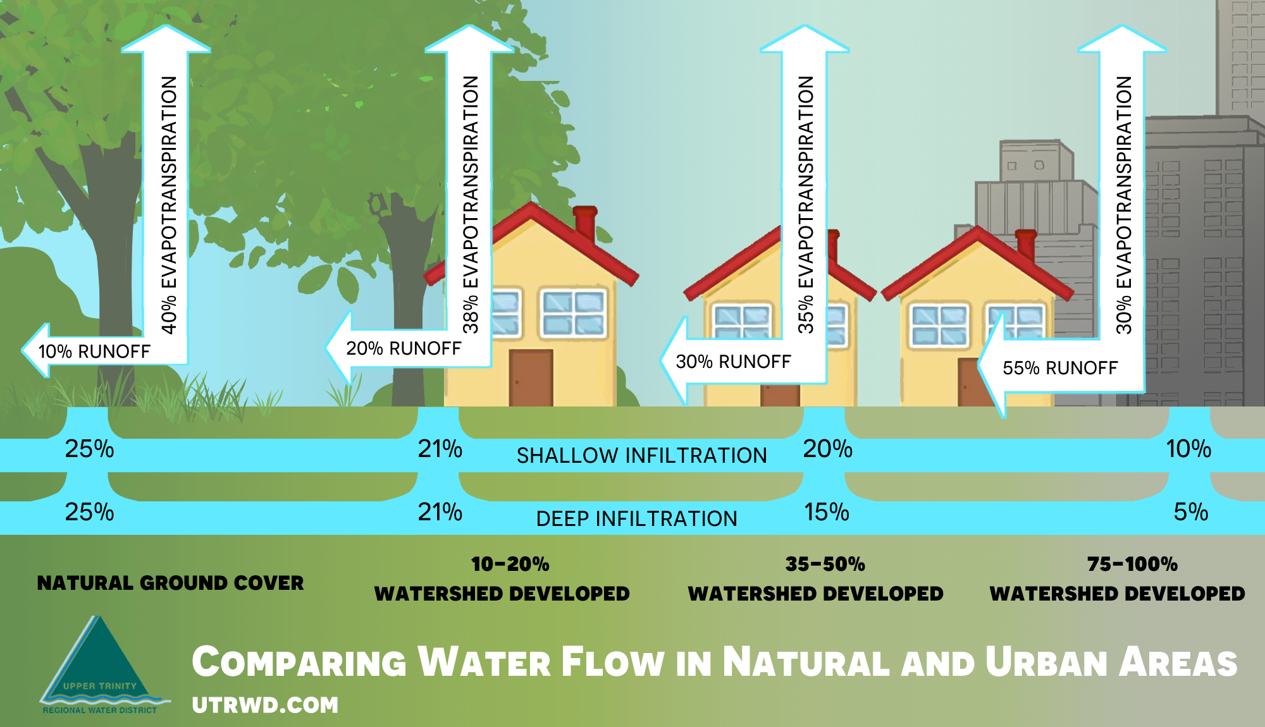
Notes:
As urbanization continues - - pervious becomes impervious - - increased run-off carrying harmful pollutants & increased flood risks
Increased nutrients from Fertilizers and lawn chemicals, bacteria, sediments & hazardous substances

Slide 4
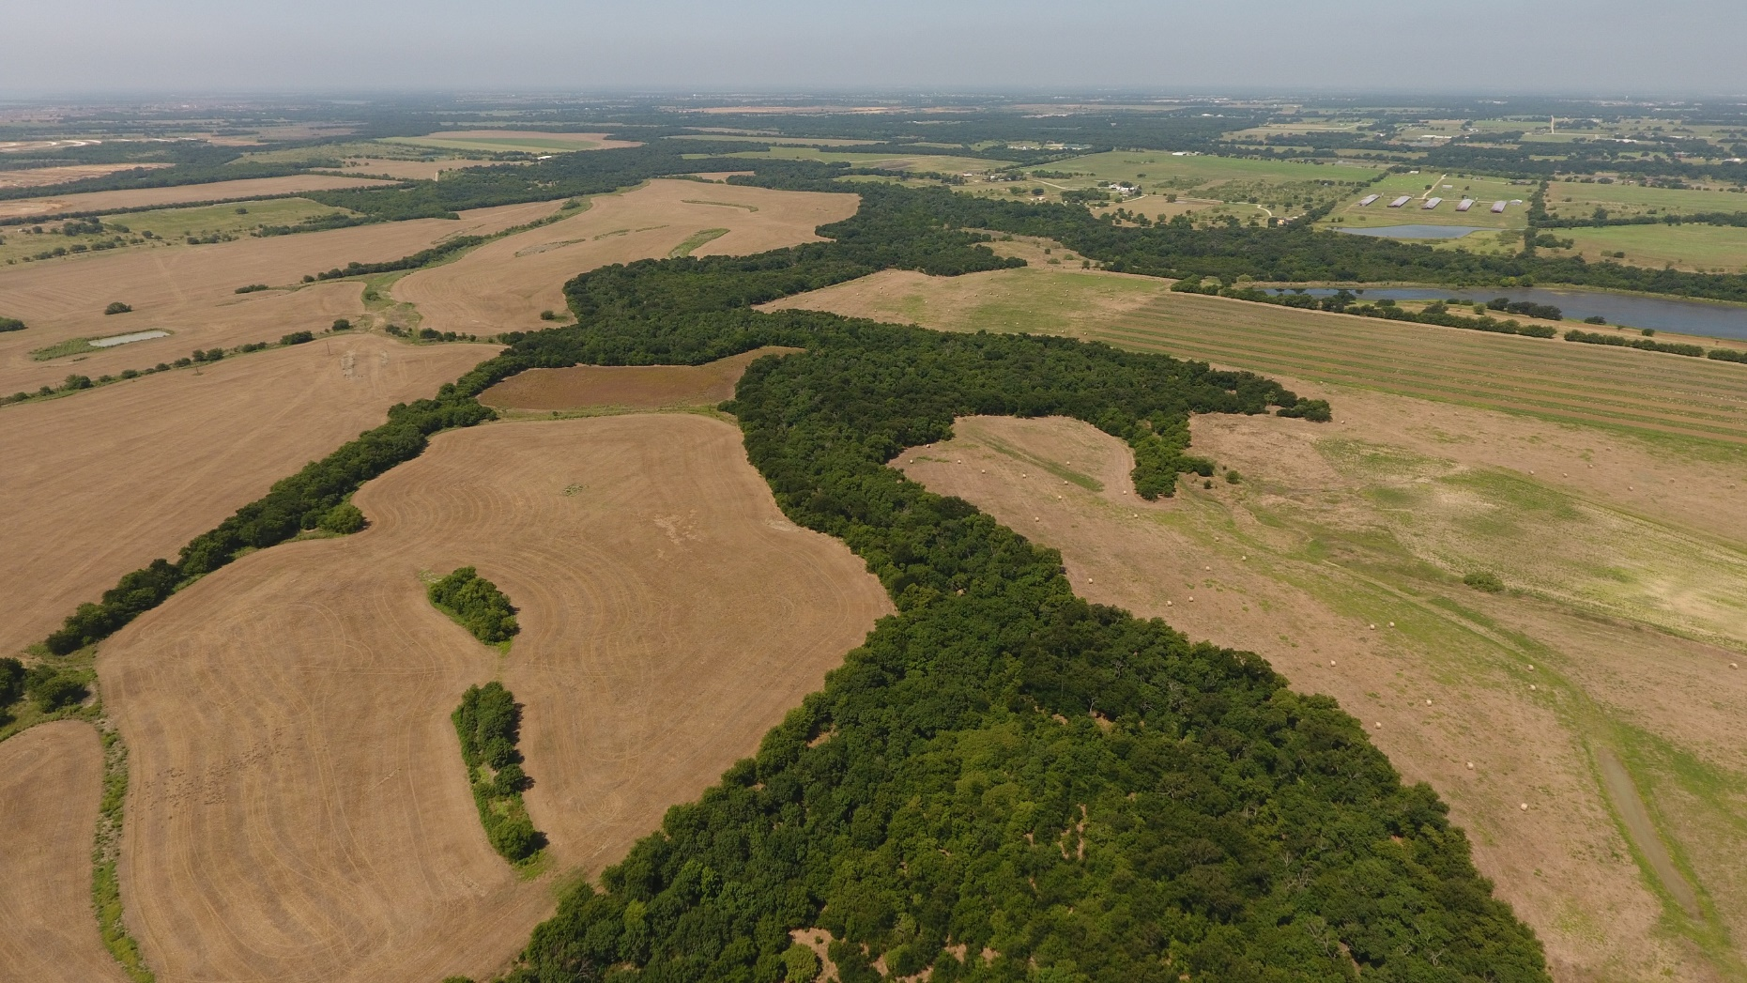
Greenbelts are Buffers
Notes:
Greenbelts acts as buffers

Slide 5
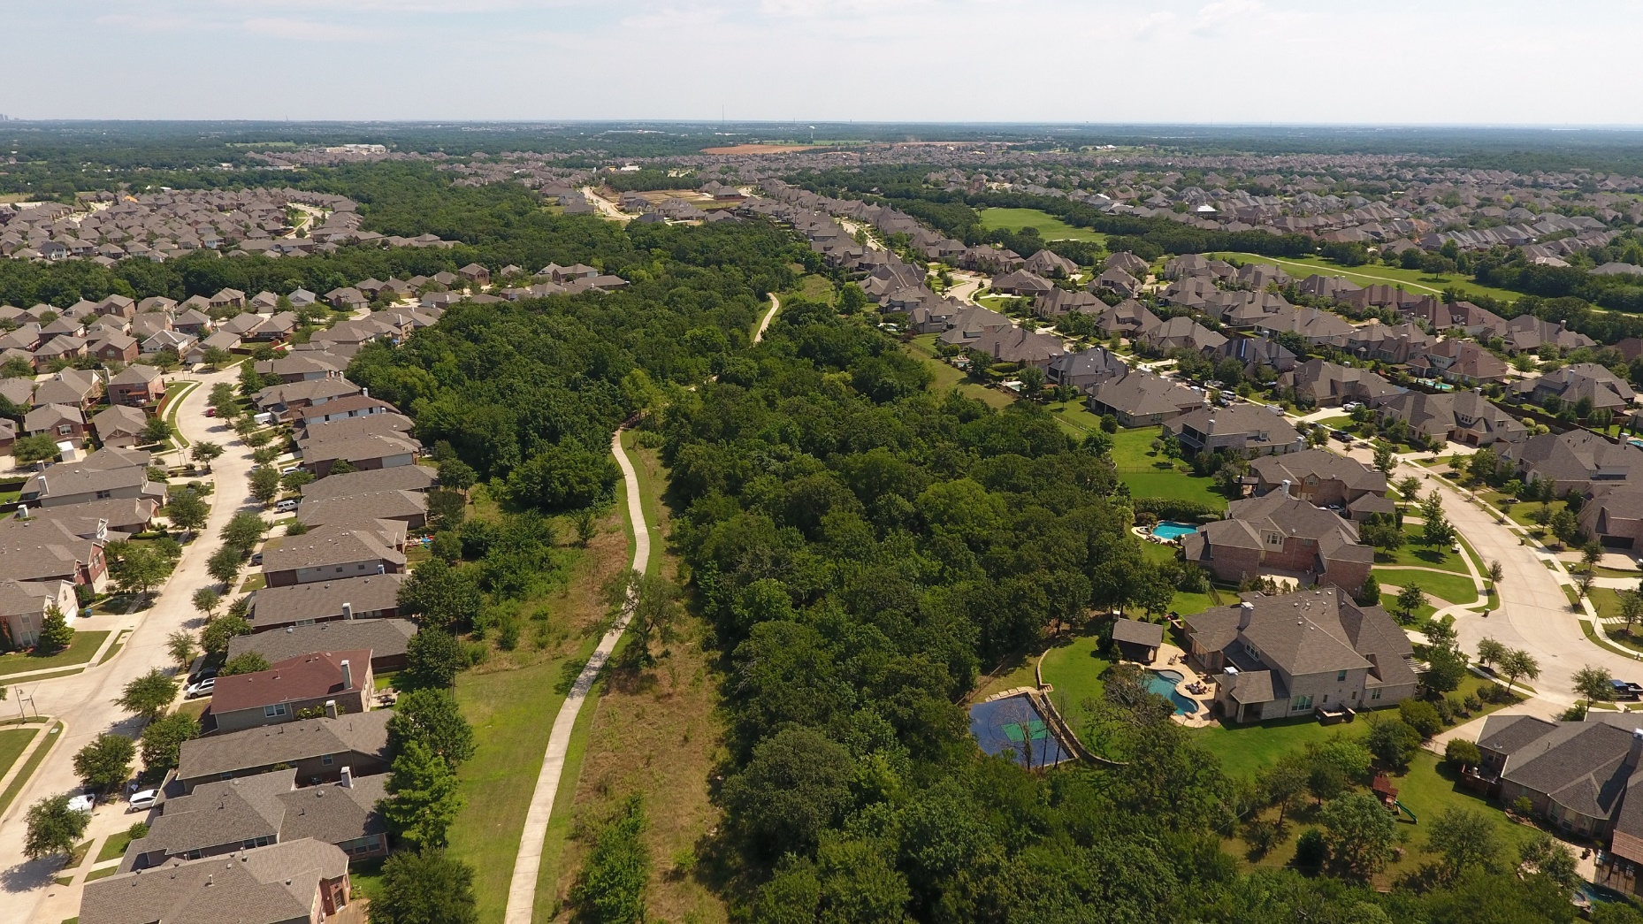
Between Waterways & Neighborhoods
Notes:
Protecting the riparian areas from development
Once these natural resources are gone - - they are gone forever

Slide 6
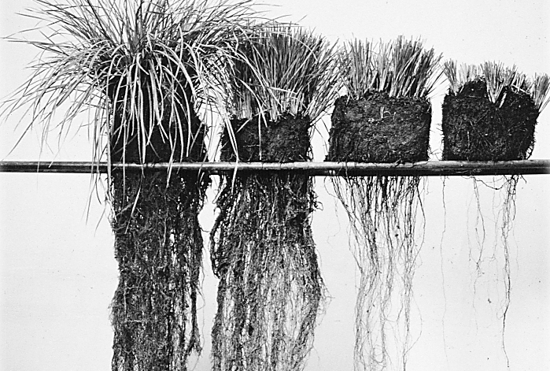
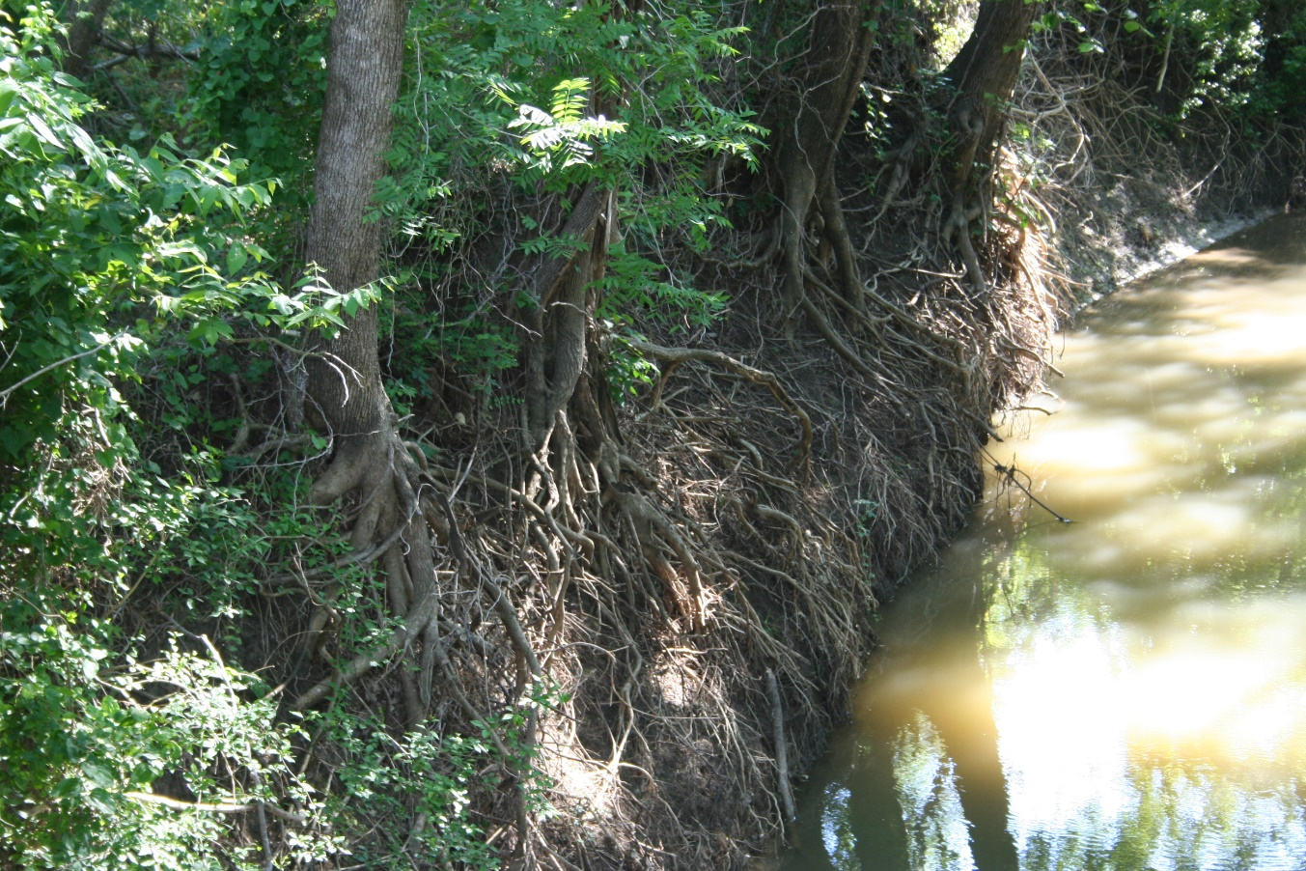
Riparian Vegetation
Stabilizes streambank soil
Dissipates floodwater energy
Filters water
Notes:
Keeping riparian vegetation intact is crucial to the health of waterways

Slide 7

Upper Trinity Conservation Trust
Established in 2010 as 501 (C)(3) Non-Profit Land Trust
Preserve Riparian Areas and other Key Watershed Features
Conservation Easements
Focuses on Lakes Lewisville, Ray Roberts and Grapevine
Landowner Outreach and Education
Notes:
Recognizing that there are still many unincorporated areas of Denton County that developers are building on, UTRWD established the Upper Trinity Conservation Trust in 2010. The
Trust focuses on protecting water quality by preserving riparian areas through conservation easements and by outreach and education to landowners. As of now we are focused on
the watersheds of lakes Lewisville, Ray Roberts and Grapevine, which is where our customers cities lie. The land trust is not affiliated with the government and has a separate Board of
Directors than the Water District.

Slide 8
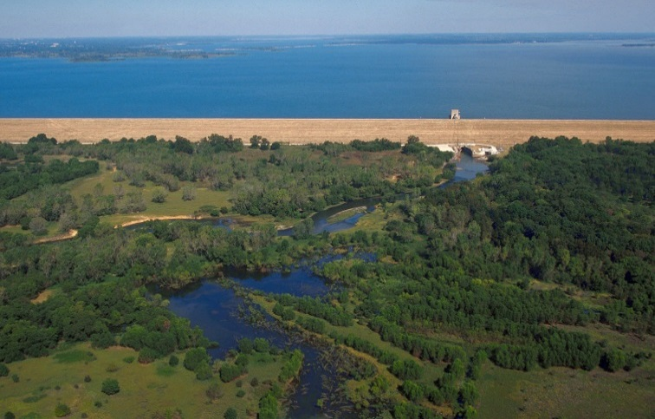
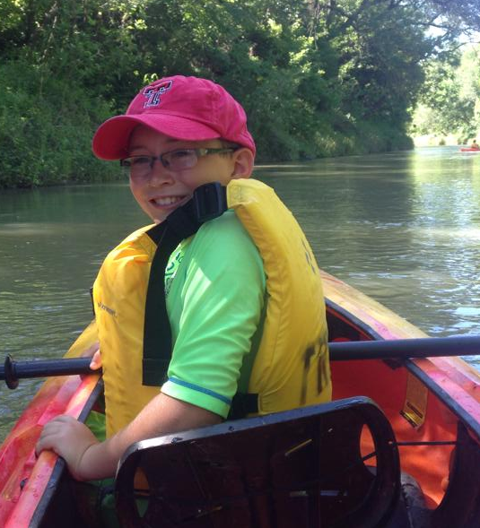
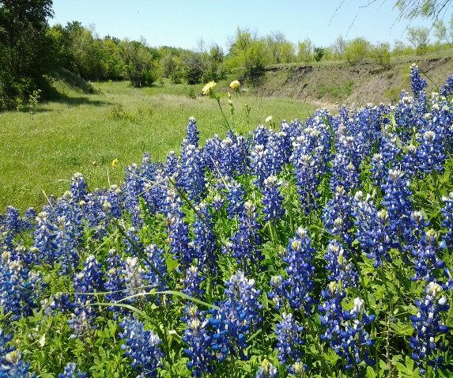
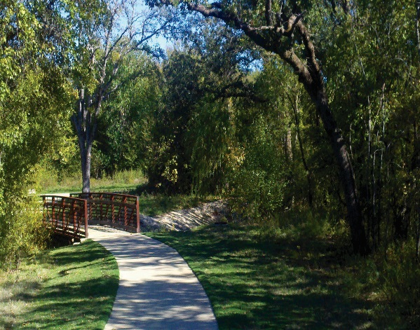
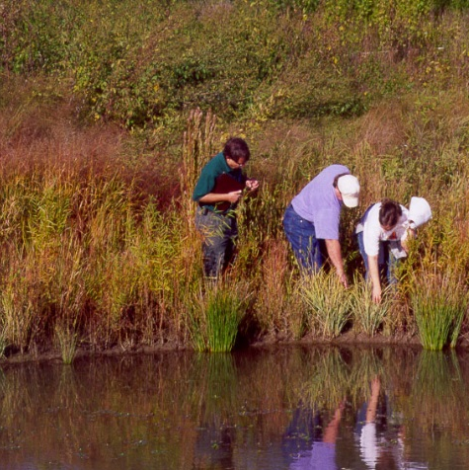
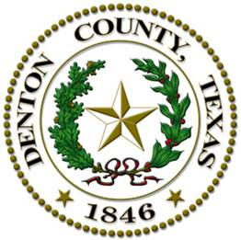
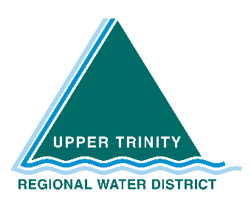
Greenbelt Plan:
Guide preservation of greenbelts and related natural areas
Identify strategic areas for establishing greenbelt corridors
Advocate a common vision for multi-use greenbelts
Provide a toolbox of implementation strategies
Notes:
The Plan is to be a guide in the voluntary preservation of greenbelts in the County, to identify and prioritize those highly valuable areas where greenbelts should be preserved, connected, or established for maximum benefit. The Plan also advocates for a common vision, providing a toolbox of strategies that the County, or any municipality, nonprofit organization and agencies, or developer can use in preserving the greenbelts “right where we live.”

Slide 9
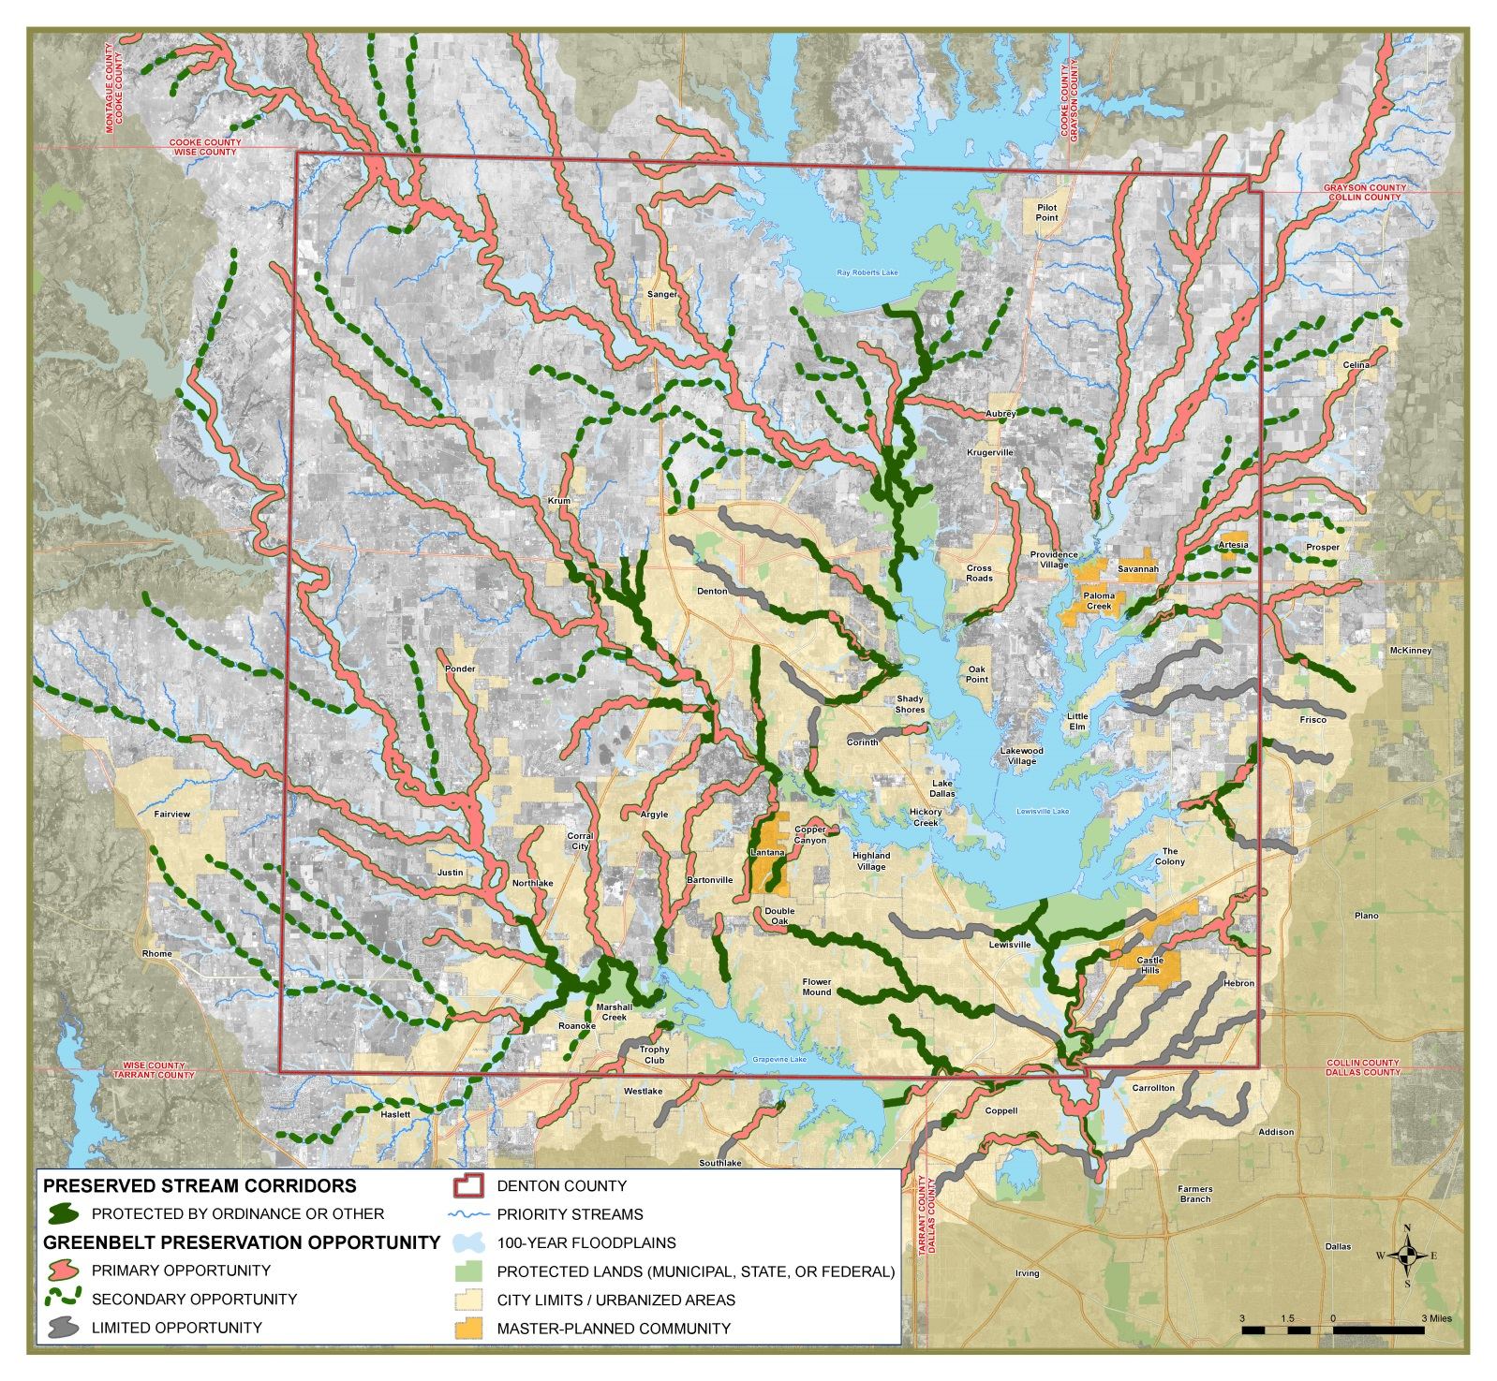
Greenbelt Opportunities
Primary
Secondary
Limited
Notes:
When you overlay the previous maps – the priority streams, the priority watersheds, existing greenbelts, greenbelt opportunity areas, existing protected streams - a plan takes shape. Whereas 100 miles of stream length are protected, we identified, through the prioritization process, nearly 1,000 miles of stream length that should be considered for protection and preservation.
We called these prioritized stream corridors Primary and Secondary opportunities for greenbelt preservation.
Primary Greenbelt Preservation Opportunity – Consists of stream corridors that meet the following criteria:
direct connection to a reservoir within Denton County,
major stream,
located with a municipality’s corporate limits within Denton County, or
located within a designated high priority watershed.
These Primary Opportunity streams may or may not have Greenbelt characteristics. Greenbelts that do not have sufficient vegetation can be allowed to restore naturally or by plantings once the area is protected and preserved.
Secondary Greenbelt Preservation Opportunity – Consists of stream corridors not included as Primary Greenbelt Preservation Opportunity, but do provide a significant contribution to Primary Opportunity corridors. Similar to Primary Opportunity streams, these Secondary Opportunity streams may or may not contain streams with Greenbelt characteristics.
Limited Greenbelt Preservation Opportunity – Consist of streams that are developed corridors – either residential or commercial – and have a minimal opportunity for Greenbelt Preservation.
Not all priority streams were provided with a Greenbelt preservation opportunity identifier. These streams consist of the less significant tributaries in the medium to low priority watersheds. If an opportunity is available to preserve these lower priority streams, it should be considered.

Slide 10
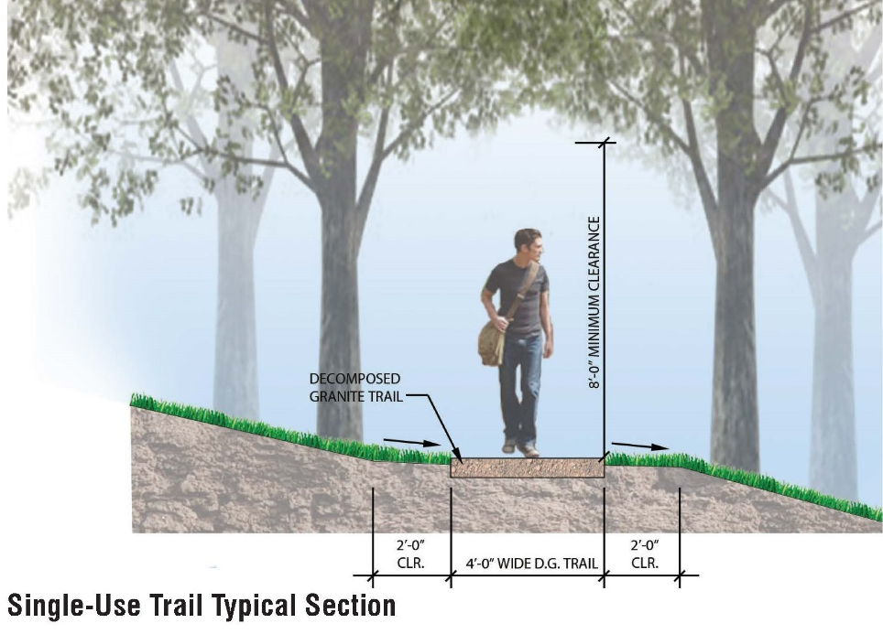
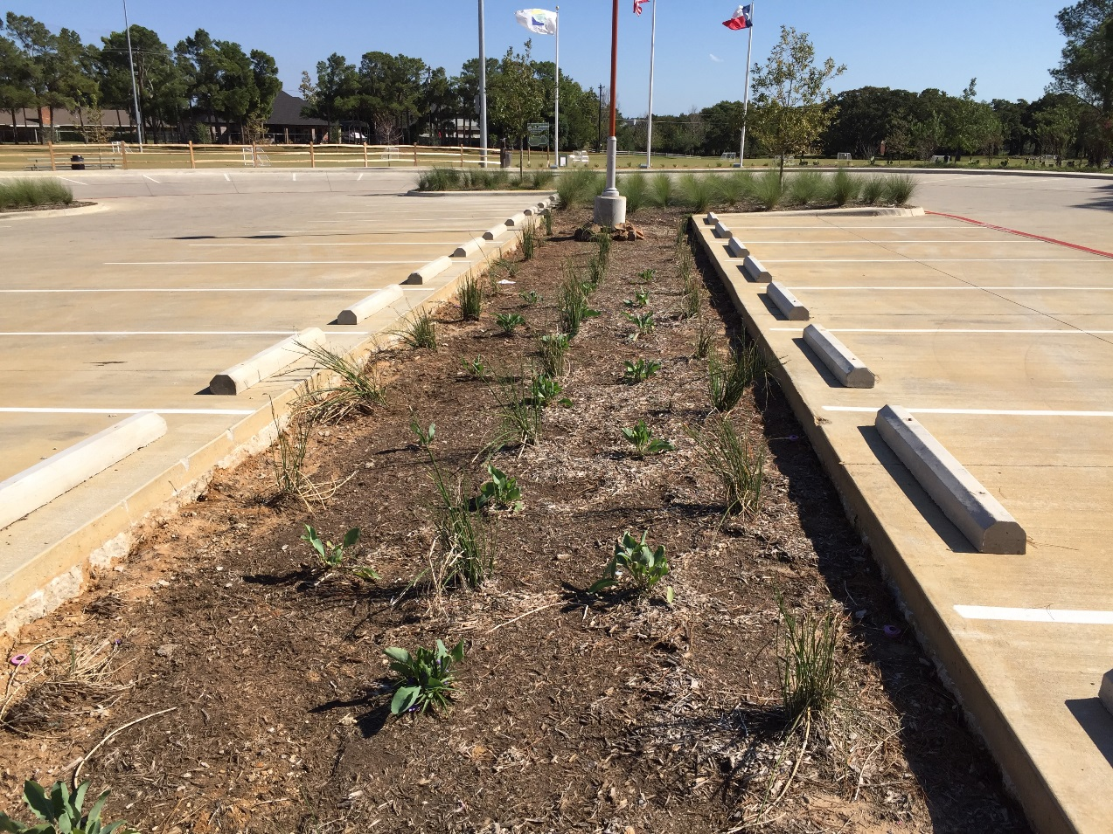
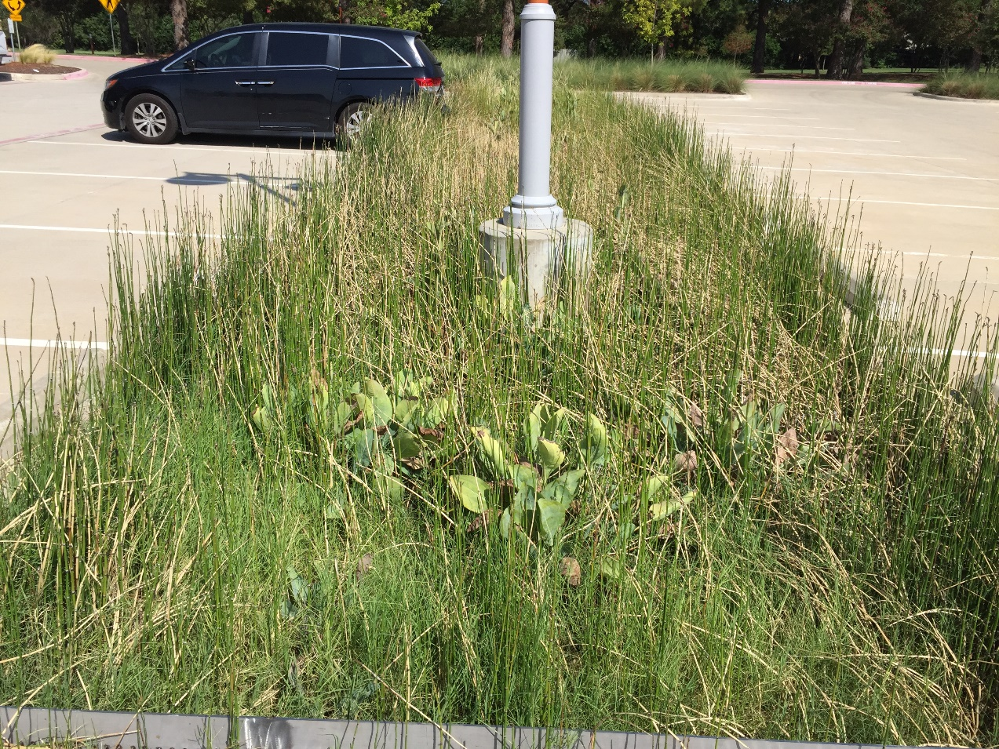
Preservation/Protection Tools
Development Standards
Conservation Easements
Alternative Development Ideas
Green Infrastructure
Trail Design Standards
Mowing Regimes
Private Landowner Resources
Notes:
Implementation of the Plan is completely voluntary for municipalities, developers and landowners. We believe that when the benefits of preserved greenbelts are realized, many will join in this effort. This is not a Plan that we want to sit on the shelf. So, to assist the municipalities, developers, and landowners in Denton County, a toolbox of implementation strategies were identified and included in the Plan. These strategies fall under three categories:
Preservation and protection tools
Private landowner tools
Acquisition and funding tools
For municipalities, ordinances or master planning may be the most effective way to preserve greenbelts within your jurisdiction by limiting encroachment and development in the floodplain. There are examples from other municipalities, such as the Cities of Denton and Frisco, and the Town of Flower Mound, to look to when considering enacting ordinances in your municipality.
Other examples include conservation easements or alternative development ideas, such as cluster or conservation developments. This image at the bottom shows what a cluster or conservation development could look like. The basic idea is that the housing units are more densely built to allow half of the land area to remain as open space and as an amenity to the neighborhood. We have an example of this in the Town of Flower Mound and their Cross-Timbers Conservation Development District, designed to protect the natural areas of the western half of the Town.
Green infrastructure or low impact development is another tool that municipalities can utilize the reduce the volume of stormwater reaching creeks and improve the quality of that water. Pictured in the top right hand corner is the parking lot of the new Double Tree Ranch Park in Highland Village. As you can see, the median area is lower than the parking spaces. As the water runs off the parking area it will flow into the this area and into a biofilter that will remove pollutants and release clean water downstream. Not only can these practices hold more water and lessen the flooding downstream, but the water released will be cleaner as well!
Much of the northern part of the County is still largely rural and privately owned. We have also included information for landowners on good land management practices that may help them understand the benefits of good riparian stewardship for their property as well as those around them, and point them to other resources that can provide more assistance to them.

Slide 11
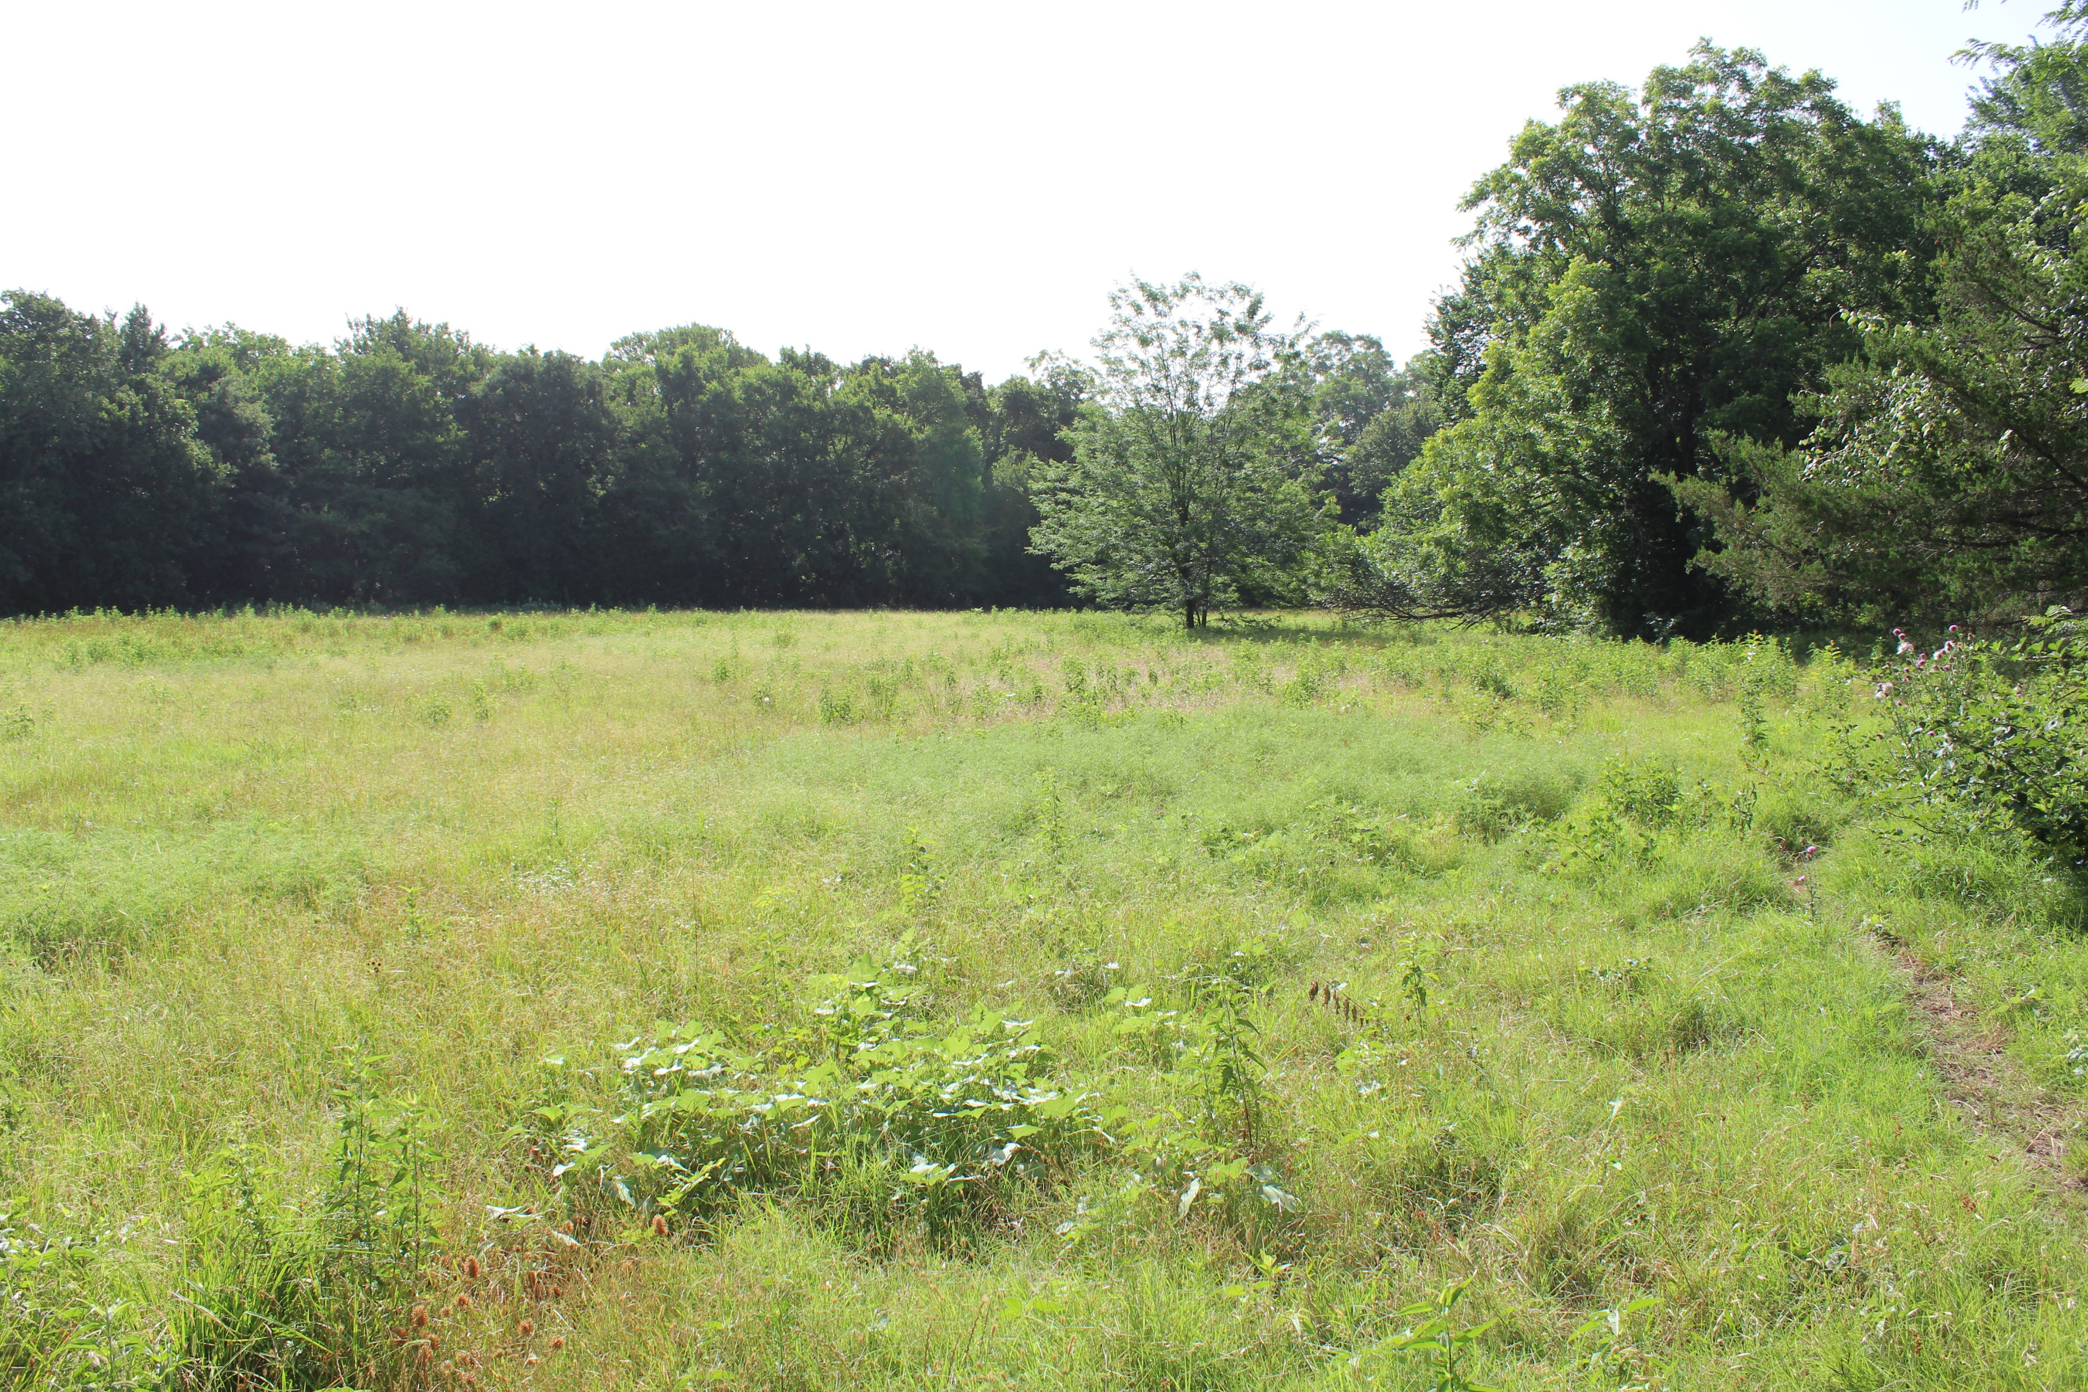
Watershed Ordinance
Floodplain must be kept in its natural state
Lowest floor in residential structure is to be at least 18-inches above 100-year flood elevation
Cross Timbers Conservation Development District
Environmental Conservation Commission
Town of Flower Mound
Notes:
Minimum Drainage Standards: the physical design of proposed subdivision or development must conform to the minimum storm sewer, drainage and floodplain criteria set forth in the Town’s engineering standards manual.
Floodplain must be kept in its natural state & no construction or construction-related activity is allowed - - whether it’s a fully developed FEMA floodplain or a flood hazard area.

Slide 12
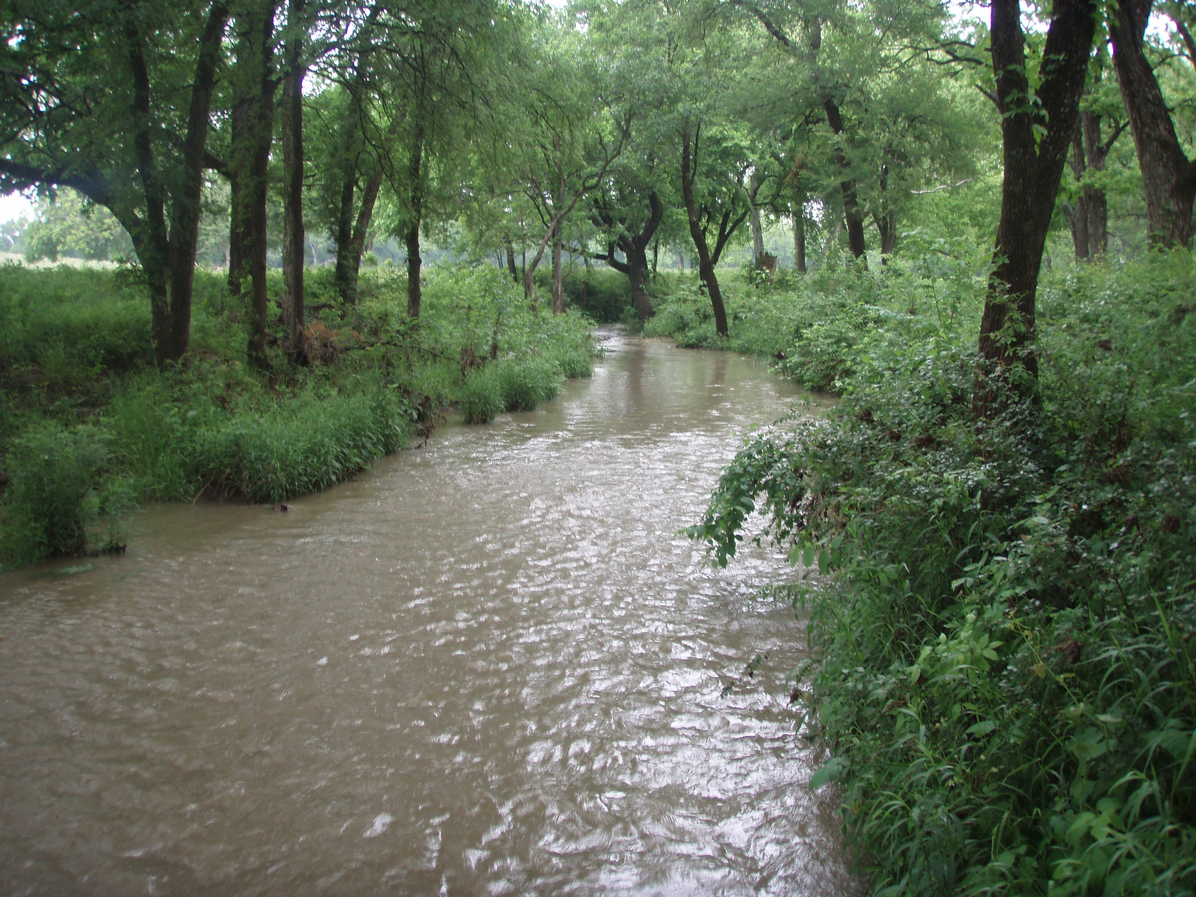
Watershed Ordinance
Restricts Development in Fully Developed Watershed to 18-inches Above 100-year Flood Elevation
Environmentally Sensitive Areas
Riparian Buffers to be Left in Natural Condition
City of Denton
Notes:
The Regional Ecosystem Framework, or REF, is a tool that identifies areas of relative ecological importance in the Dallas-Fort Worth region. Transportation partners and local governments that are developing infrastructure projects can use the REF as a preliminary screening tool to identify environmental impacts their projects may have and identify mitigation areas to offset any impacts.

Slide 13
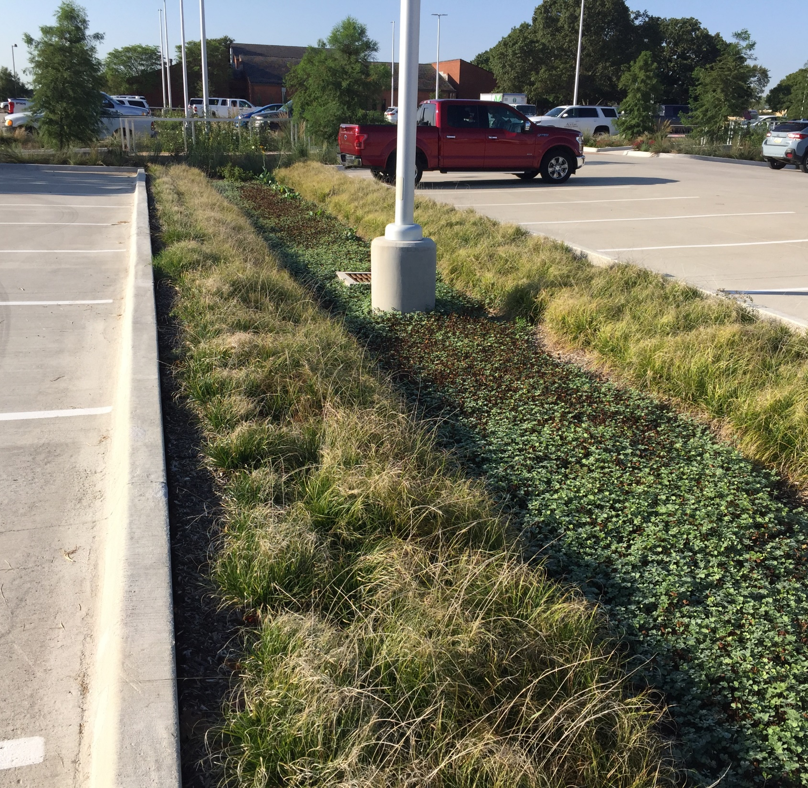

Regional Stormwater Management Guidance Manual
Manage Water Quality, Streambank Protection, Stormwater Conveyance & Flood Control Issues
Allows Flexibility to Apply at Local Level
North Central Texas Council of Gov’t
Notes:
The Regional Ecosystem Framework, or REF, is a tool that identifies areas of relative ecological importance in the Dallas-Fort Worth region. Transportation partners and local governments that are developing infrastructure projects can use the REF as a preliminary screening tool to identify environmental impacts their projects may have and identify mitigation areas to offset any impacts.

Slide 14
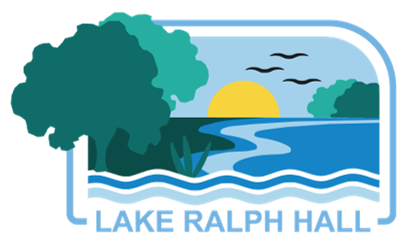


@UTRWD
@UTRWD
LakeRalphHall.com
Jason Pierce
jpierce@utrwd.com
www.utrwd.com
utct.org
Follow Us!

