Slide 1
Letter of Map Revision Review
November 3, 2023

Slide 2
What is a Letter of Map Revision?

Slide 3
Map Revision Process
Requestor
Local FPA
FEMA
Develops data
Prepares MT-2 Forms
Notifies property owners
Reviews for compliance with local ordinances
Certifies notification of property owners for floodway revisions
Reviews for compliance with Federal regulation
Issues Determination Document
Produces revised map
Signs MT-2 Form

Slide 4
Map Revision Process with SARA
Requestor
Local FPA
SARA
Develops data
Prepares MT-2 Forms
Notifies property owners
Reviews for compliance with local ordinances
Certifies notification of property owners for floodway revisions
Reviews for compliance with Federal regulation
Produces revised map
FEMA
Issues Determination Document
Maintains online model inventory
Signs MT-2 Form

Slide 5
SARA’s Role
Technical review – FEMA guidelines and standards
Regulatory review – NFIP Regulations
Draft Determination Document and attachments

Slide 6
Motivation
Protect Floodplain Mapping Investment
Form Local Service/Partnerships
Coordinate Floodplain Activities
Notes:
SARA wanted to protect the significant investments made during FEMA MapMod.
SARA managed the DFIRM studies for all of four counties, Bexar, Wilson, Karnes and Goliad Counties.
This project consisted of the modeling, re-validation of models, and mapping for the four SARB counties.
This map modernization for the SARA was a $16.4 million dollar effort, with FEMA contributing $1.8 million and SARA and partners bringing $14.6 million.
SARA’s role was that of a project manager, ensuring quality assurance and quality control.
As a LOMR Review Partner, this is a step towards CONTINUOUS MODEL MAINTENANCE---the ultimate goal.
SARA monitors, updates, maintains, stores, and distributes FEMA effective models to represent the latest changes to floodplains in our areas.
The objective is to protect the integrity of the effective model set and reduce investments needed for floodplain mapping updates in the future.
LOMR Review Program also offers SARA the opportunity to better serve their partners by providing more efficiency in case reviews along with
fostering local partnerships provides increased local control and greater ownership of flood risk data. This is the immediate goal.
A related objective is to monitor and coordinate concurrent and ongoing development activity within watersheds.

Slide 7
How did we become a LOMR Review Partner?
Cooperating Technical Partner
Technical and administrative capacity
Required training from FEMA
Partnership Agreement with FEMA
Additional LOMR Review training
Local Authority
Funding

Slide 10
Outreach to Floodplain Administrators
Initial
Ongoing
Technical check-ins
Training
Notes:
Outreach is a continuous process.
Phase 1 – explain the roles that SARA is seeking with LOMR Delegation
Phase 2 – inform the actual start date to the communities
Phase 3 – outreach is ongoing even after the start.

Slide 11
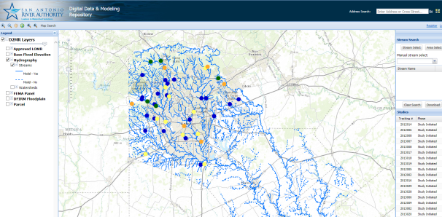
Digital Data and Modeling Repository
www.d2mr.sara-tx.org
Notes:
Part of agreement with FEMA to share model data & supporting documentation through locally managed web application.
Data can be located and downloaded through a map interface.
Used by floodplain administrators and local engineering/developer community (and university students)
Has feature to track current study locations and status – allows for collaboration between projects.

Slide 12
Benefits of LOMR Review Partner
Promotes local ownership of flood maps
Reduce overall application review time
Available to meet with applicant before LOMR is submitted and during review of LOMR
Local knowledge of the floodplains and prior/pending development
Site visits are more practical

Slide 13
Win-Win!
FEMA
CTP
Shared responsibility
Improved partnership
Higher case quality equals faster reviews at lower cost
Greater risk ownership
Community service & trust
Increase awareness leading to improved FPM
Notes:
What are the benefits of LOMR delegation? And to whom?
FEMA benefits through…
Local communities benefit by….
Ultimately, these benefits transfer to citizens and tax payers. So it is actually a win-win-win!

Slide 14
Contact Information
Erin Cavazos, P.E., CFM
Engineering Manager
600 E. Euclid Ave. , SATX 78212-4405
(210) 227-1373 Direct Line (210) 302-3269 Fax (210) 858-0265
Toll Free Number 1-866-345-7272 Email: ecavazos@sariverauthority.org
www.sara-tx.org
Joe G. Fernandez, CFM
Project Management Associate
600 E. Euclid Ave. , SATX 78212-4405
(210) 227-1373 Direct Line (210) 302-3675 Fax (210) 858-0265
Toll Free Number 1-866-345-7272 Email: josef@sariverauthority.org
www.sara-tx.org

