Slide 1
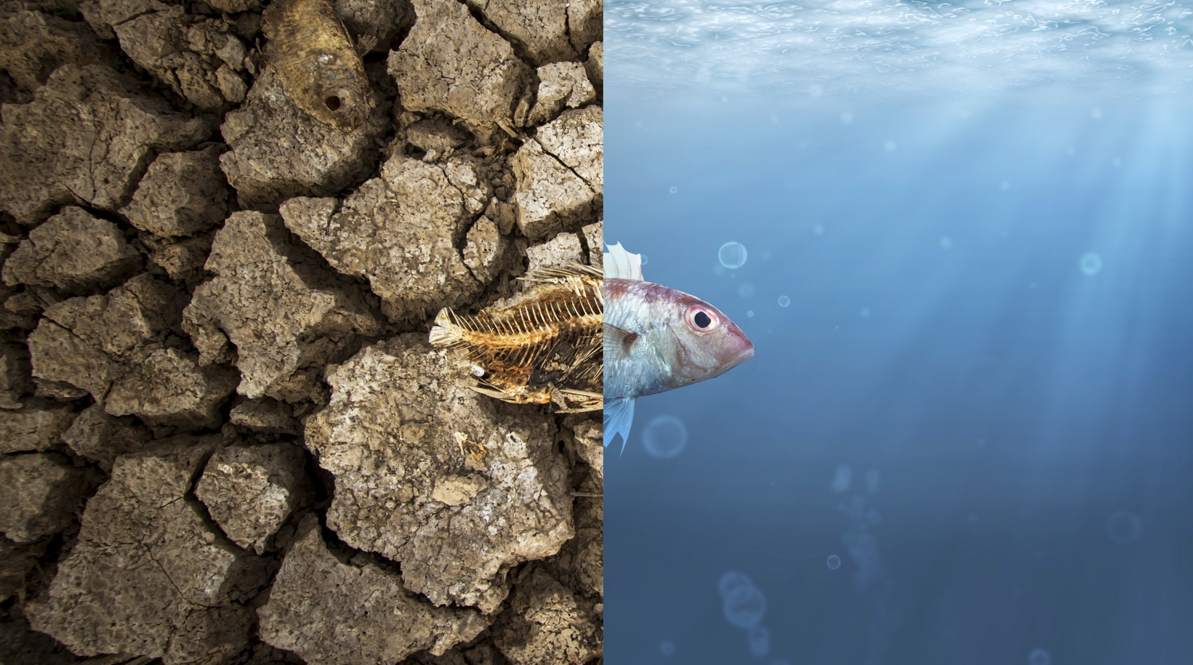
The State of Texas Desalination
Fall Conference
November 2023
Bill Norris, P.E.

Slide 2
2001 Rio Grande
Mexico
Texas

Slide 3
2011 Lake Conroe

Slide 4
2011 Lake Travis

Slide 5
Valley Desal Historical Timeline
La Sara 1.0 mgd
Donna 2.5 mgd
Owassa 3.5 mgd
N Cameron 2.5 mgd
Doolittle 3.5 mgd
7.5 mgd Plant and well field
Expansion to 20 mgd
Pretreatment and Expansion
2026 Construction
2028 Start Up
2025 Design
Reservoir Storage
?
2023
2033
2000 Feasibility
2001 Test Drilling
2002 Design
2013 Design
2024 Design
2003 Construction
2014 Construction
2026 Start Up
2004 Start Up
2015 Start Up
2025 Construction
1985 BPUB Trip to Florida
1995 BPUB Pilot Study
1999 VMUD RO
Expansion to 12 mgd

Slide 9
The State of Texas Desalination
Fall Conference
November 2023
Bill Norris, P.E.

